Slide 1
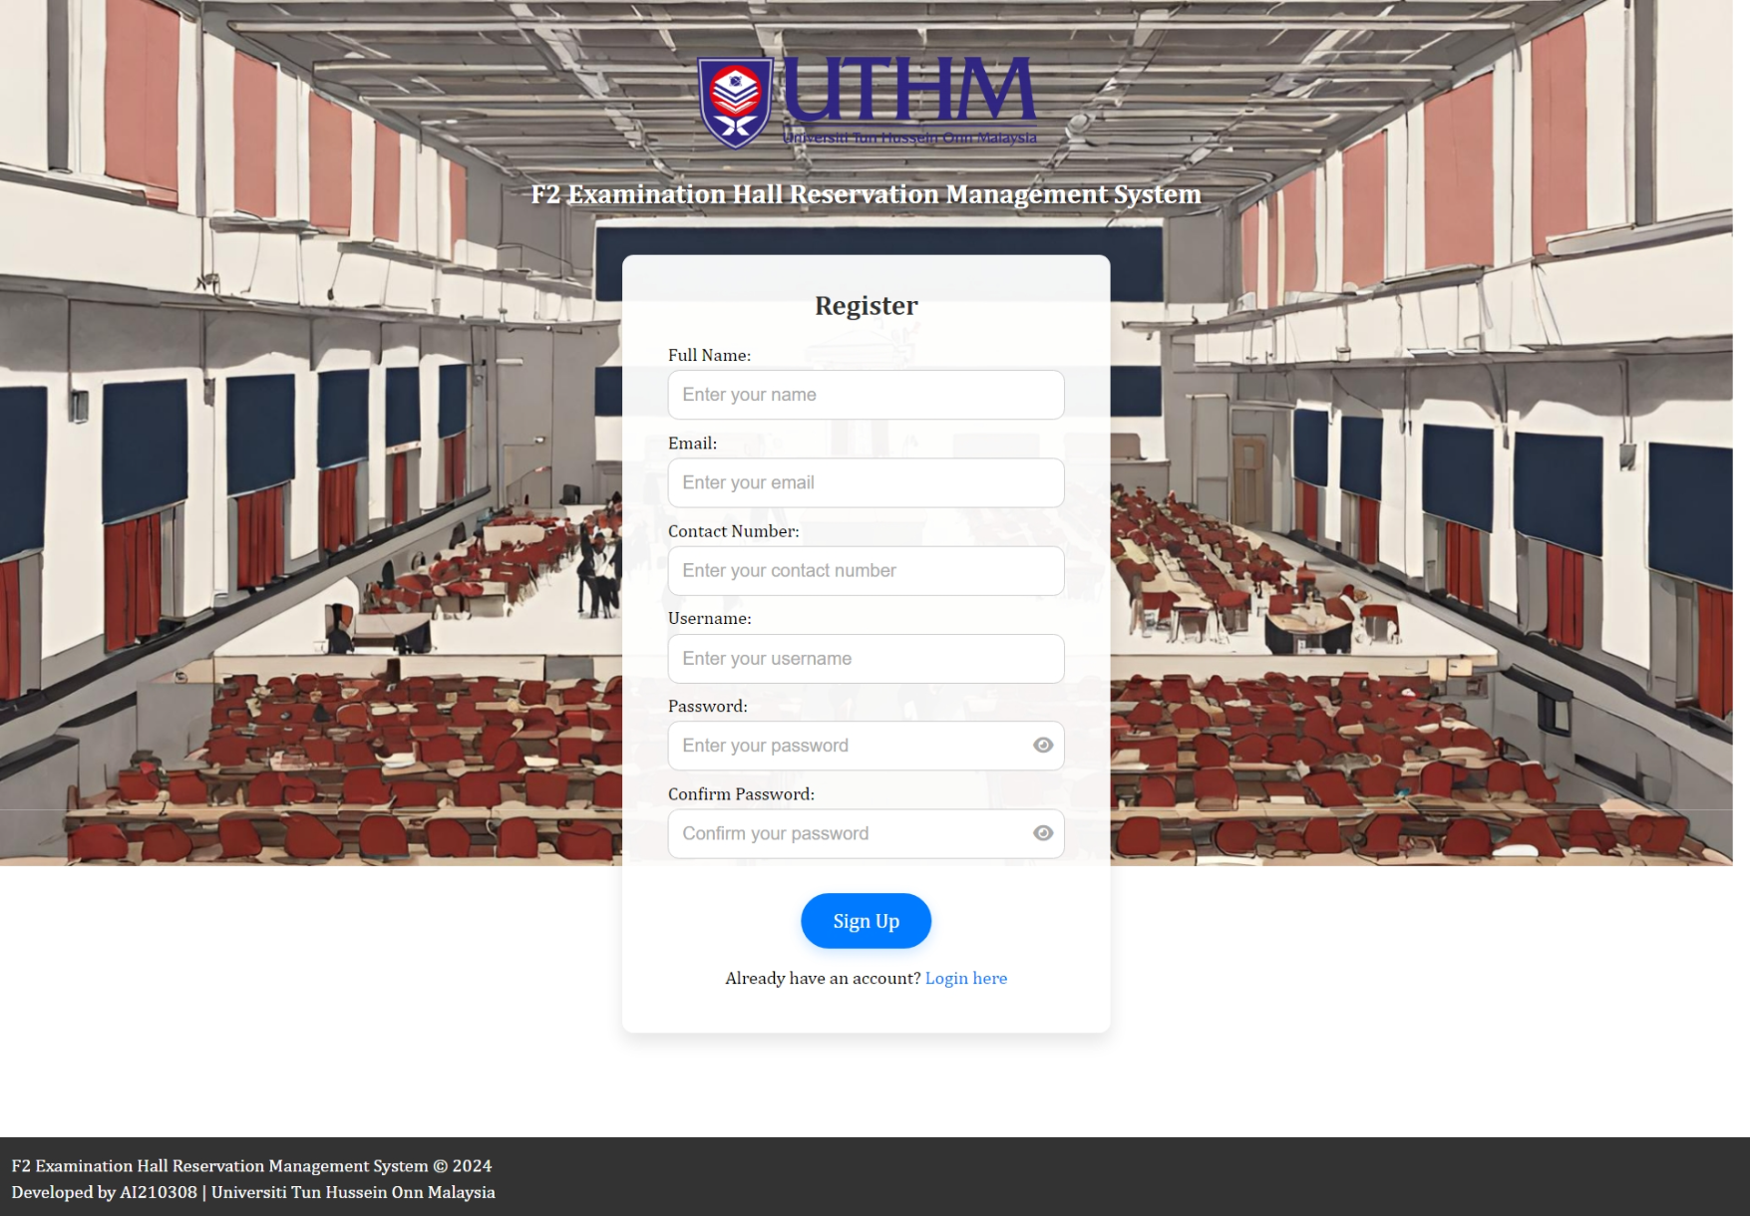
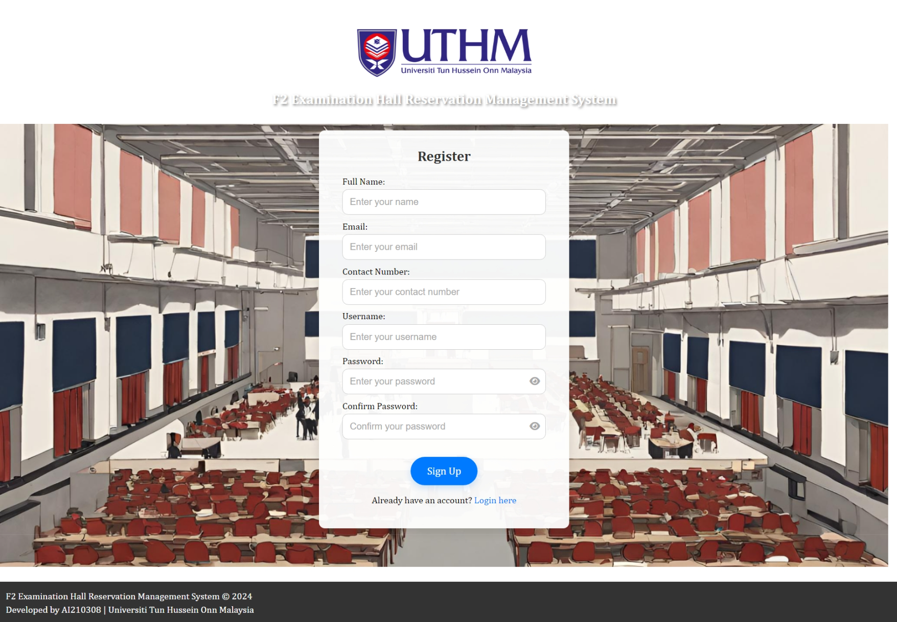
Fill in the required information to register

Slide 2
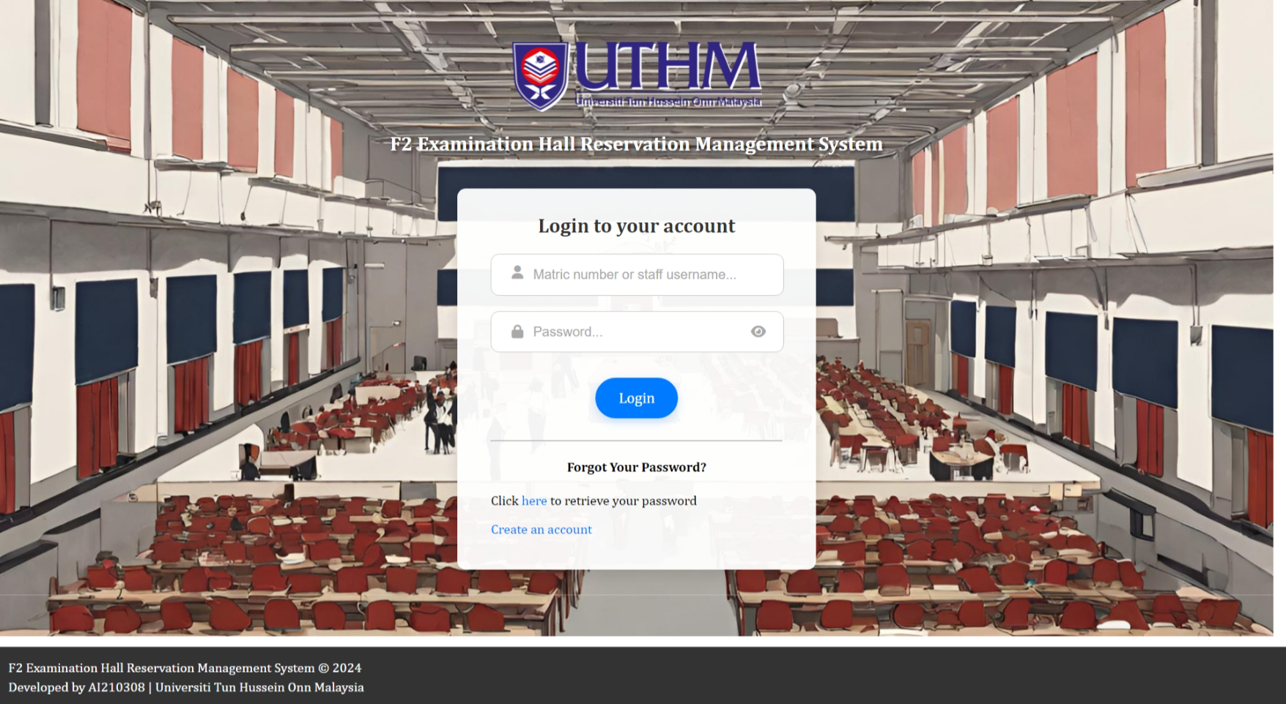
Fill in the username & password to login
Retrieve account password via the link

Slide 3
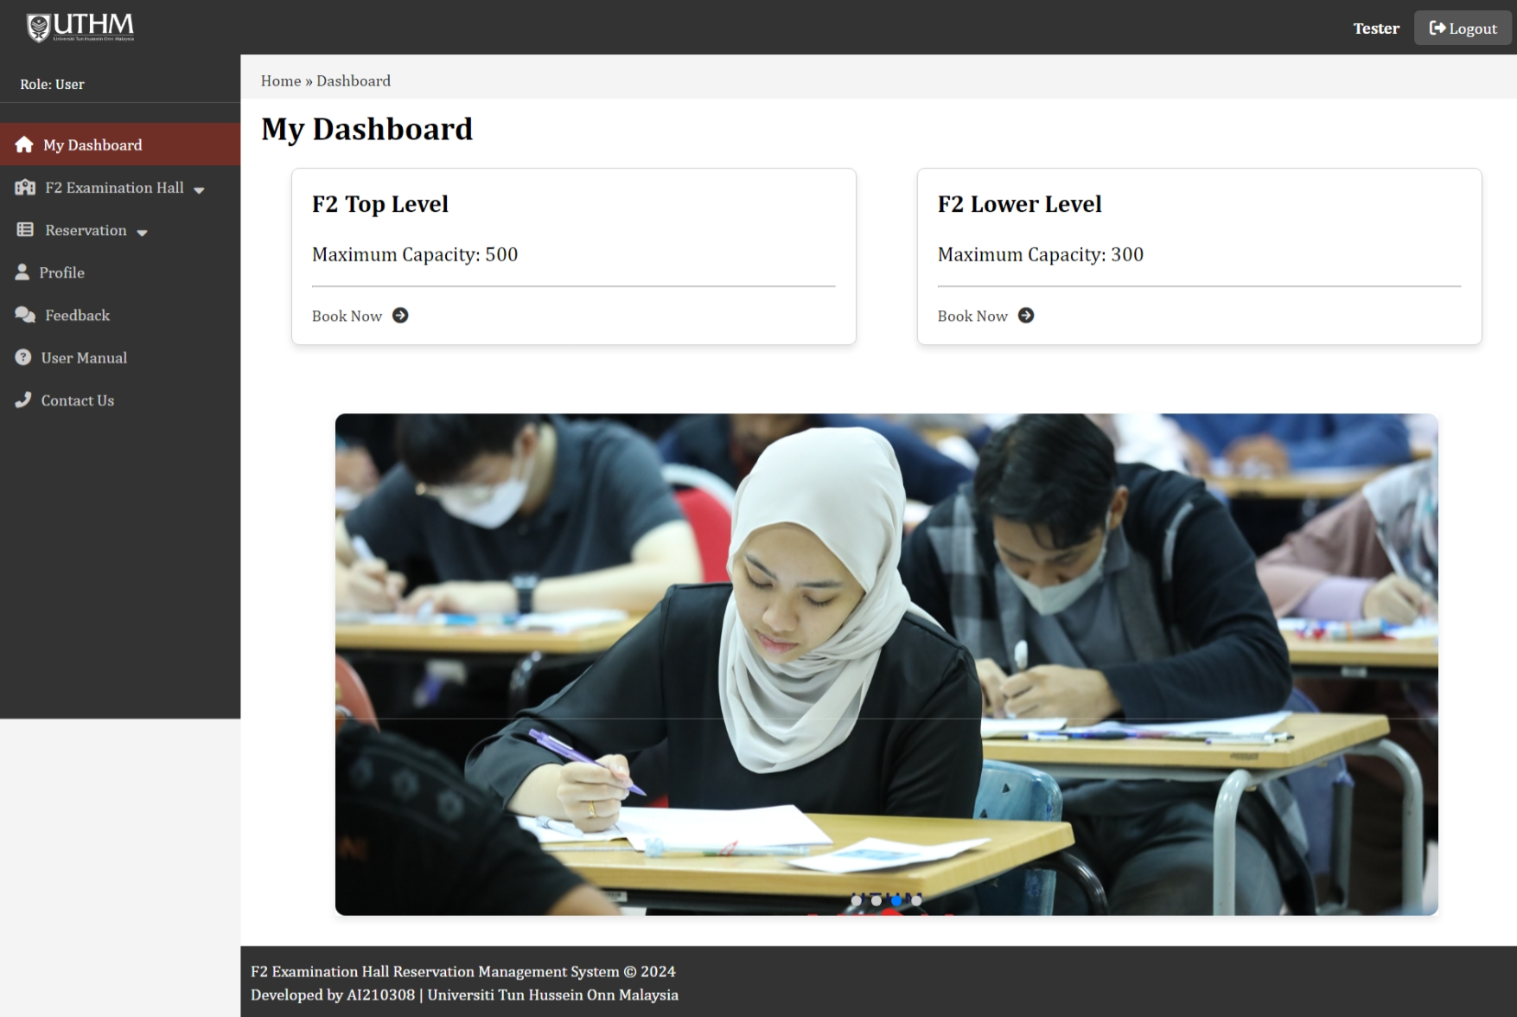
View maximum capacity and navigate to make new booking

Slide 4
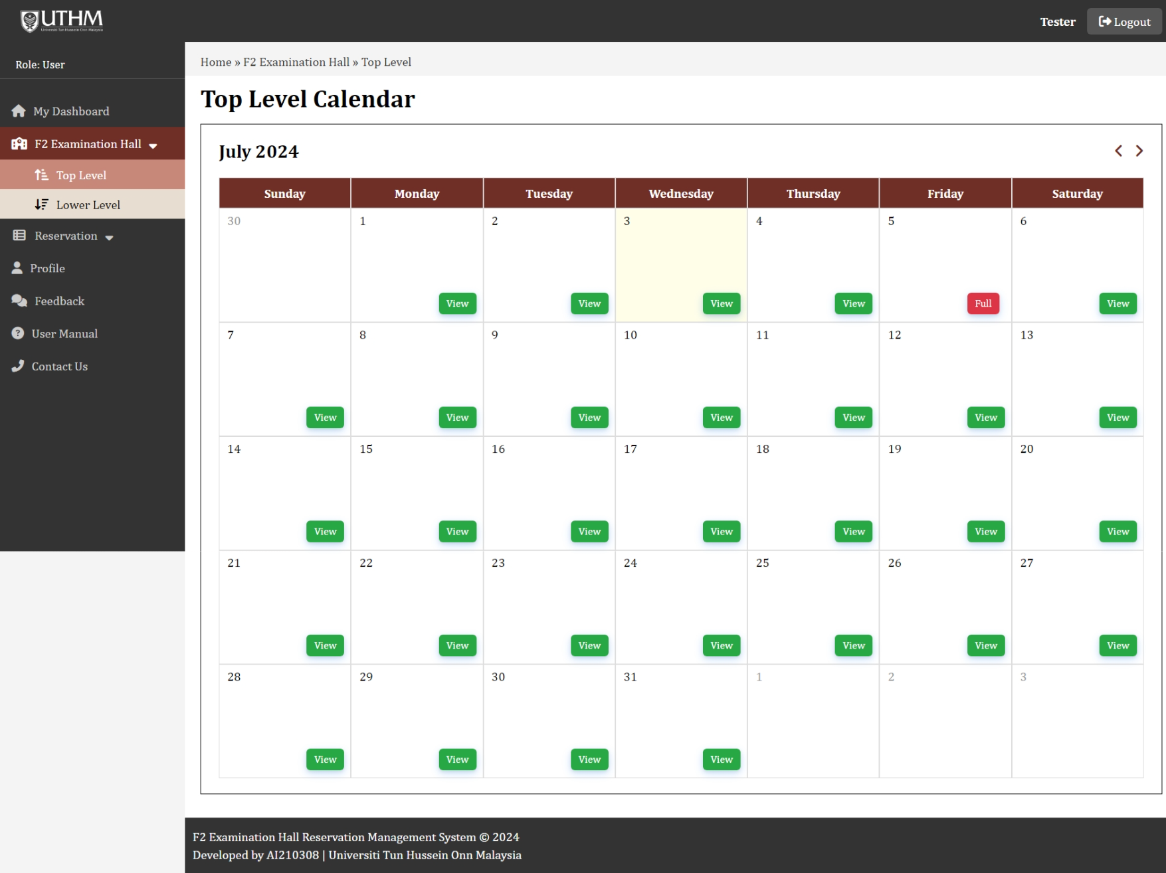
Navigate between different month and year
Current month and year display
Current date
The date is fully reserved
The date is available to book

Slide 5
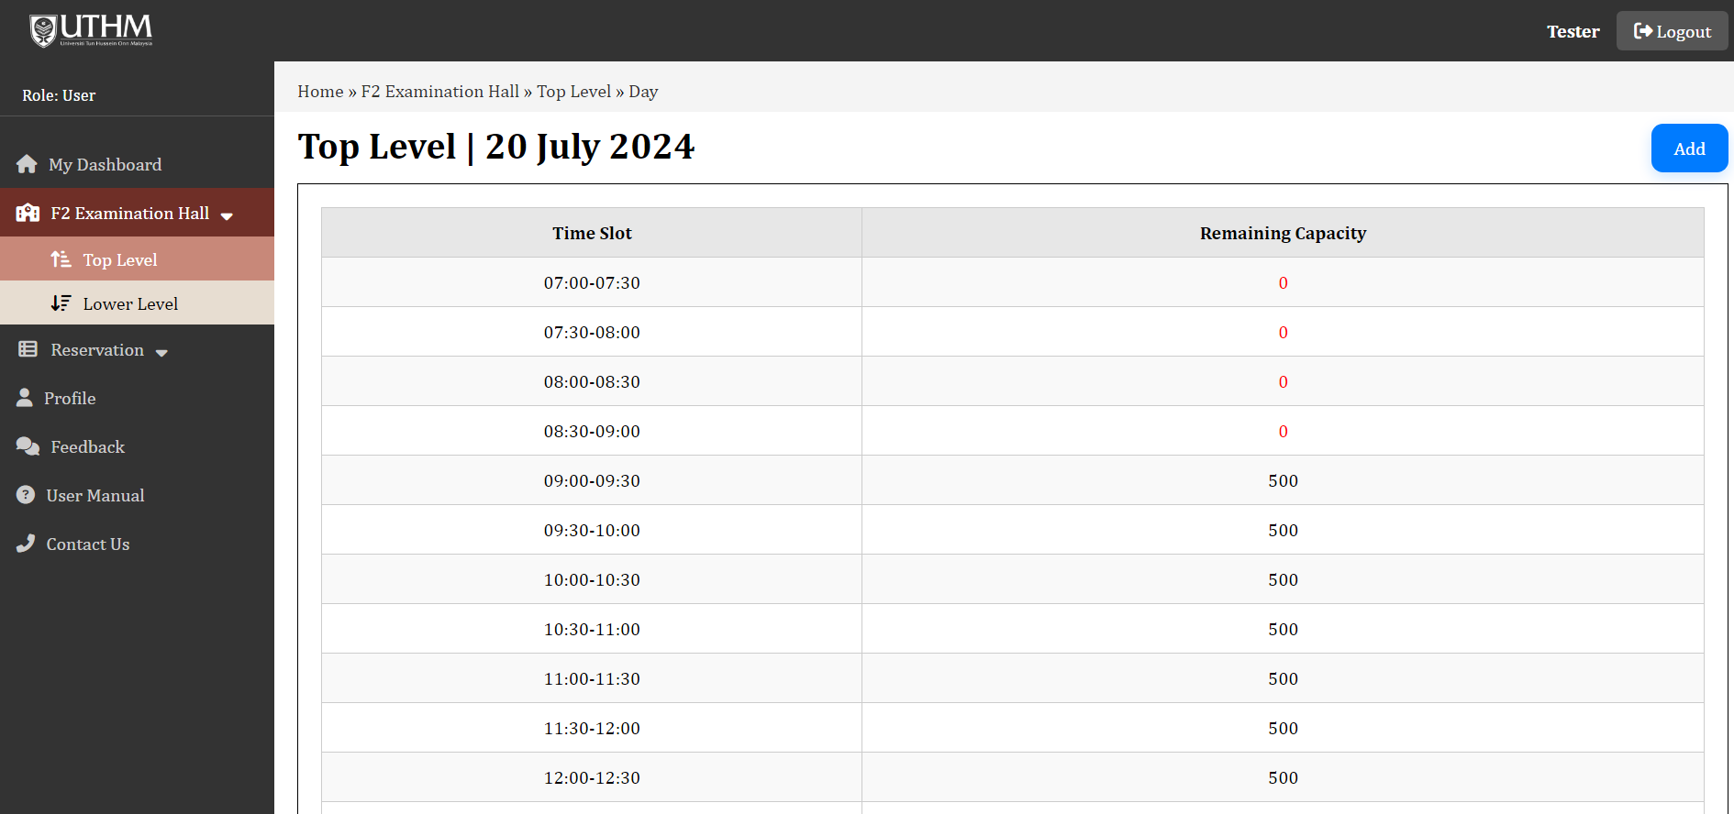
View the remaining capacity of each time slot before reservation

Slide 6
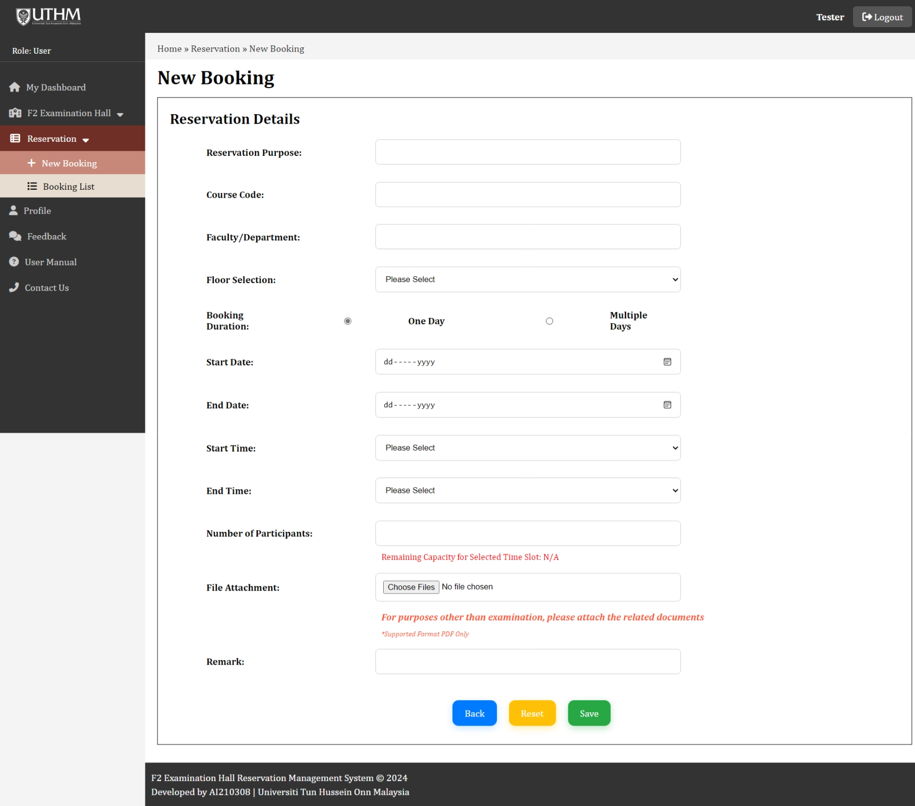
Choose “Multiple Days” if you want to make reservation for consecutive days
The remaining capacity will show after the floor, booking duration, start date, end date, start time and end time are selected
Upload related files for purposes other than examination

Slide 7
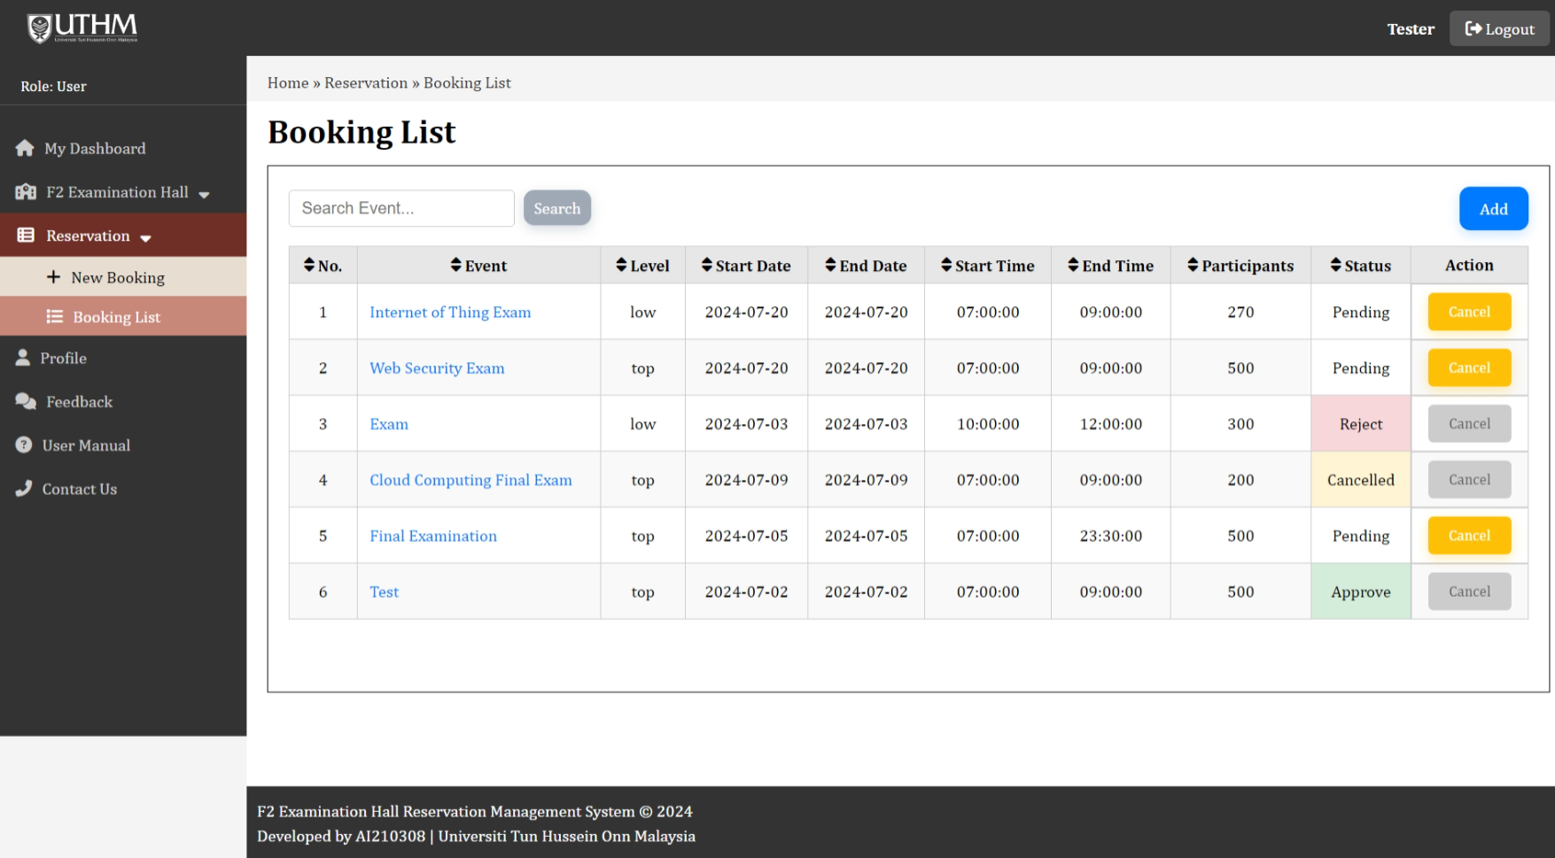
You are permitted to cancel the booking while its status is pending. For modifications when the status has changed, please get in touch with us directly.
View the reservation details by clicking on the Event name

Slide 8
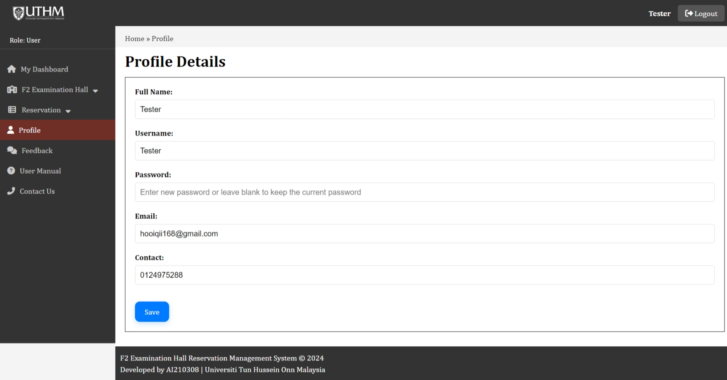
Enter new password if you wish to change your account password, or else leave it blank to maintain the original account password

Slide 9
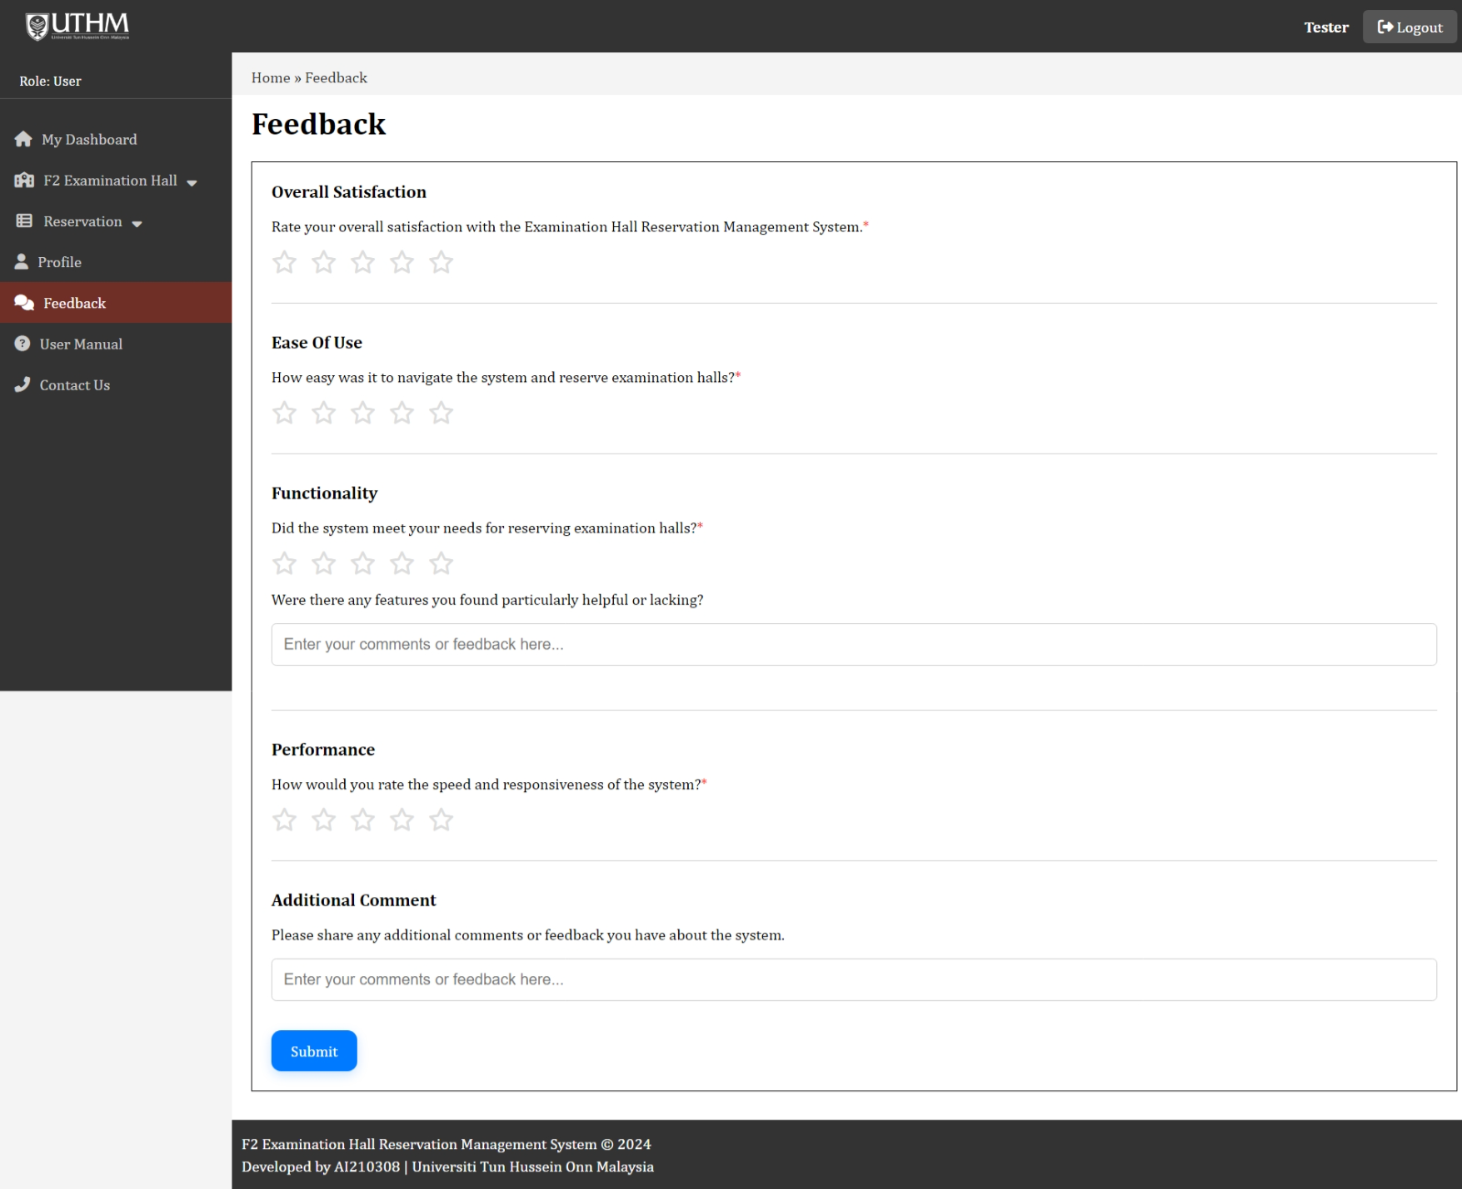
Rate the system by clicking on the star icon
Fill in any comment about the system (optional)

Slide 10
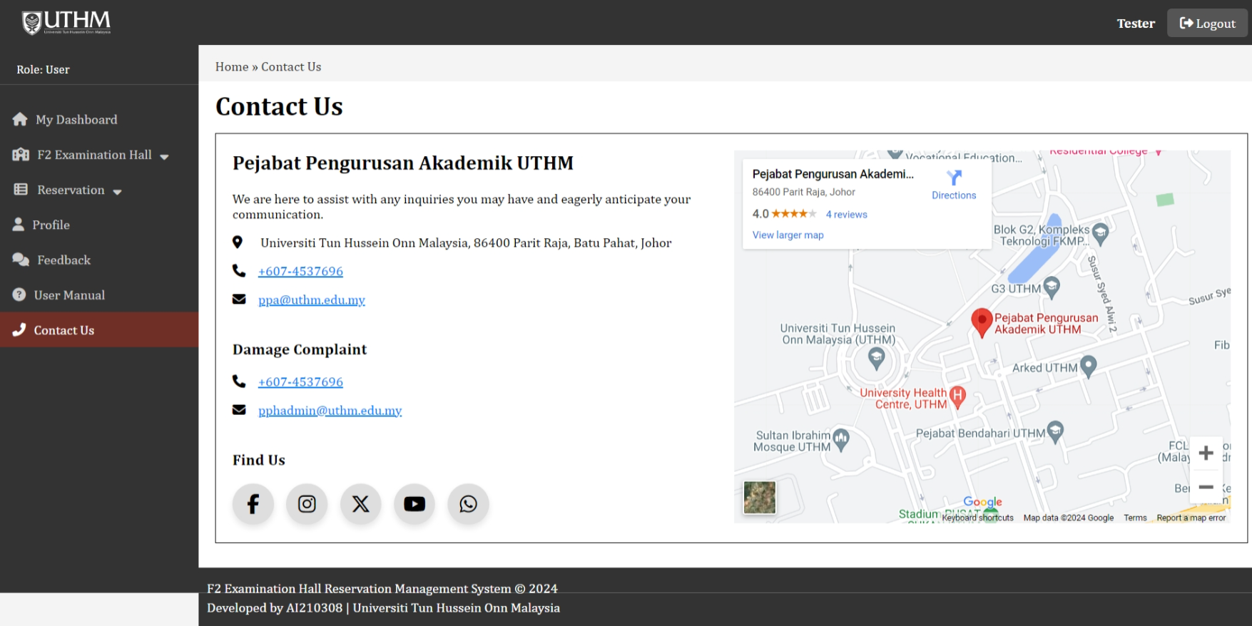
Hyperlink to the social media platform

